Slide 1
COMP 520 - Compilers
Lecture 12 – Runtime Organization + Hardware

Slide 2
Grades on Canvas
I have added your grades to canvas. If something is missing or incorrect, let me know.
If you turned in an assignment late, it is likely incorrect on canvas and I will fix it as soon as I can.
COMP 520: Compilers – S. Ali

Slide 3
Today’s Goals
Be convinced that assembly, hardware, and the CPU in general is not magic
COMP 520: Compilers – S. Ali

Slide 4
Today’s Goals
Be convinced that assembly, hardware, and the CPU in general is not magic
First: Simple hardware organization (COMP-541)
Second: Modern CPU organization (COMP-311)
Lastly: x86 assembly
COMP 520: Compilers – S. Ali

Slide 5
Goals
Be convinced that assembly, hardware, and the CPU in general is not magic
First: Simple hardware organization (COMP-541/311)
Second: Modern CPU organization (COMP-311)
Lastly: x86 assembly
Not tested in this class, covered for your benefit
COMP 520: Compilers – S. Ali

Slide 6
Goals
Be convinced that assembly, hardware, and the CPU in general is not magic
First: Simple hardware organization (COMP-541/311)
Second: Modern CPU organization (COMP-311)
Lastly: x86 assembly
This will be VERY useful when working on PA4, covered for your benefit
COMP 520: Compilers – S. Ali

Slide 7
Goals
Be convinced that assembly, hardware, and the CPU in general is not magic
First: Simple hardware organization (COMP-541/311)
Second: Modern CPU organization (COMP-311)
Lastly: x86 assembly
This is PA4
covered for your benefit
COMP 520: Compilers – S. Ali

Slide 8
Demystifying Hardware
An extended commercial for COMP-541
COMP 520: Compilers – S. Ali

Slide 9
Some coverage of the ALU
In the interest of time, will only cover some parts of the ALU (Arithmetic Logic Unit)
Specifically, let’s cover the adder (where a subtracter is just a small, clever modification)
Not Tested Material
COMP 520: Compilers – S. Ali

Slide 10
What is 2’s complement?
Not Tested Material
COMP 520: Compilers – S. Ali

Slide 11
What is 2’s complement?
Bits | Unsigned value | Signed value (Two's complement)
0000 0000 | 0 | 0
0000 0001 | 1 | 1
0000 0010 | 2 | 2
0111 1110 | 126 | 126
0111 1111 | 127 | 127
1000 0000 | 128 | −128
1000 0001 | 129 | −127
1000 0010 | 130 | −126
1111 1110 | 254 | −2
1111 1111 | 255 | −1
Not Tested Material
COMP 520: Compilers – S. Ali

Slide 12
Motivation: Example Goal
Add the following:
0000 0101
+ 0000 1101
Not Tested Material
COMP 520: Compilers – S. Ali

Slide 13
Let’s first focus on single bit addition
0 + 0
0 + 1
1 + 0
1 + 1
Not Tested Material
COMP 520: Compilers – S. Ali

Slide 14
Let’s first focus on single bit addition
0 + 0 0
0 + 1
1
1 + 0
1 + 1
Not Tested Material
COMP 520: Compilers – S. Ali

Slide 15
Let’s first focus on single bit addition
0 + 0 0
0 + 1
1
1 + 0
1
1 + 1
10?
Not Tested Material
COMP 520: Compilers – S. Ali

Slide 16
1+1 Gets an entire slide!
Let’s rewrite this:
1+1 = 0 (carry 1)
Not Tested Material
COMP 520: Compilers – S. Ali

Slide 17
Let’s first focus on single bit addition
0 + 0 0 c0
0 + 1
1 c0
1 + 0
1 c0
1 + 1
0 c1
Not Tested Material
COMP 520: Compilers – S. Ali

Slide 18
Motivation: Example Goal
Add the following:
0000 0101
+ 0000 1101
0c1
Not Tested Material
COMP 520: Compilers – S. Ali

Slide 19
Let’s first focus on single bit addition
0 + 0 + c1 1 c0
0 + 1 + c1
1 + 1 + c1
Not Tested Material
COMP 520: Compilers – S. Ali

Slide 20
Let’s first focus on single bit addition
0 + 0 + c1 1 c0
0 + 1 + c1
0 c1
1 + 1 + c1
1 c1
Not Tested Material
COMP 520: Compilers – S. Ali

Slide 21
Motivation: Example Goal
Add the following:
0000 0101 5
+ 0000 1101 +13
0001 0010 18
c1
c1
c1
Not Tested Material
COMP 520: Compilers – S. Ali

Slide 22
Can we come up with something more formal? What does this look like in hardware?
COMP 520: Compilers – S. Ali

Slide 23
Truth Tables (COMP-283)
$$A$$ | 0 | 0 | 1 | 1 | 0 | 0 | 1 | 1
$$B$$ | 0 | 1 | 0 | 1 | 0 | 1 | 0 | 1
$$C_{in}$$ | 0 | 0 | 0 | 0 | 1 | 1 | 1 | 1
$$S$$ | 0 | 1 | 1 | 0 | 1 | 0 | 0 | 1
$$C_{out}$$ | 0 | 0 | 0 | 1 | 0 | 1 | 1 | 1
Not Tested Material
COMP 520: Compilers – S. Ali

Slide 24
Truth Tables (COMP-283)
$$A$$ | 0 | 0 | 1 | 1 | 0 | 0 | 1 | 1
$$B$$ | 0 | 1 | 0 | 1 | 0 | 1 | 0 | 1
$$C_{in}$$ | 0 | 0 | 0 | 0 | 1 | 1 | 1 | 1
$$S$$ | 0 | 1 | 1 | 0 | 1 | 0 | 0 | 1
$$C_{out}$$ | 0 | 0 | 0 | 1 | 0 | 1 | 1 | 1
If odd number of 1s: S=1, otherwise S=0 What is the boolean logic look like?
Not Tested Material
COMP 520: Compilers – S. Ali

Slide 25
Truth Tables (COMP-283)
$$A$$ | 0 | 0 | 1 | 1 | 0 | 0 | 1 | 1
$$B$$ | 0 | 1 | 0 | 1 | 0 | 1 | 0 | 1
$$C_{in}$$ | 0 | 0 | 0 | 0 | 1 | 1 | 1 | 1
$$S$$ | 0 | 1 | 1 | 0 | 1 | 0 | 0 | 1
$$C_{out}$$ | 0 | 0 | 0 | 1 | 0 | 1 | 1 | 1
$$S=C_{in}⊕A⊕B$$
Where $⊕ ≡$ exclusive or
Not Tested Material
COMP 520: Compilers – S. Ali

Slide 26
Adder Boolean Algebra
$S=C_{in}⊕A⊕B$
$C_{out}=\left(C_{in}∧\left(A⊕B\right)\right)∨\left(A∧B\right)$
And what can we do with boolean algebra?
Not Tested Material
COMP 520: Compilers – S. Ali

Slide 27
Single Bit Adder
A B
C
A B
A B
C
S
$$C_{out}$$
Not Tested Material
COMP 520: Compilers – S. Ali

Slide 28
1-Bit Adder
A B
$$C_{out}$$
$$C_{in}$$
S
Not Tested Material
COMP 520: Compilers – S. Ali

Slide 29
4-Bit Adder
Coming Soon!
$$A_{3} B_{3}$$
$$A_{2} B_{2}$$
$$A_{1} B_{1}$$
$$A_{0} B_{0}$$
CF
$$S_{3}$$
$$S_{2}$$
$$S_{1}$$
$$S_{0}$$
Not Tested Material
COMP 520: Compilers – S. Ali

Slide 30
Adder Input/Output
A=0000 0101 5
+B=0000 1101 +13
S=0001 0010 18
Where 18= $S_{0}+2S_{1}+4S_{2}+…$
Aka, $S=\sum_{i}{S_{i}⋅2^{i}}$
Not Tested Material
COMP 520: Compilers – S. Ali

Slide 31
Thus, Hardware IS NOT Magic
Addition is not magic, it is simple simple circuitry
But it would be a stretch to say that “the rest of the hardware follows similarly”
If you are curious, see COMP-541
Not Tested Material
COMP 520: Compilers – S. Ali

Slide 32
CPU Organization
COMP 520: Compilers – S. Ali

Slide 33
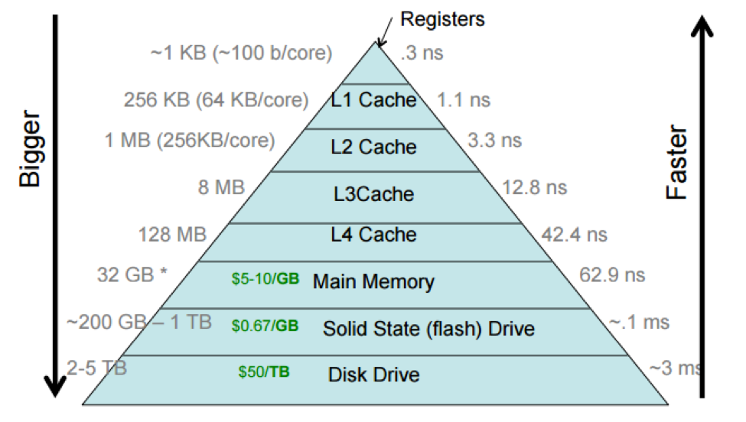
Cache Hierarchy
L1 Cache: Paper on Desk
L2 Cache: Go to bookshelf
L3: Go to local library
RAM: It’s in another library in North Carolina
COMP 520: Compilers – S. Ali (Credit: J. H. Anderson)

Slide 34
Storage access time
1) Head to the North Atlantic Ocean
2) Sail to London
3) Go to Oxford
4) Wait in line for the Oxford English dictionary, make copies of what you need
5) Sail back
COMP 520: Compilers – S. Ali (Credit: J. H. Anderson)

Slide 35
Thankfully, Memory is Memory
From the perspective of the machine code, accessing memory looks the same (not counting page faults, for that, see COMP-530 and 630 to implement it)
This means we don’t consider “where” memory is in cache to be relevant when writing machine code
All handled by the hardware to be nearly invisible
COMP 520: Compilers – S. Ali

Slide 36
So what types of memory DO we worry about?
Stack
Heap
Segments:
.text (Executable section)
.bss (Uninitialized static data)
.data (Initialized static data)
We will discuss .idata and other segments later
COMP 520: Compilers – S. Ali

Slide 37
Data Segment
Consider static elements such as:
class A {
private static int a = 0;
private static String b = “Hello World”;
}
COMP 520: Compilers – S. Ali

Slide 38
Variable data known before runtime
private static int a = 0;
private static String b = “Hello World”;
So instead of having to do an initialization step:
“Store 0 at data 0x5000”, “Store ‘Hello World\0’ at data 0x5004”
COMP 520: Compilers – S. Ali

Slide 39
Variable data known before runtime
private static int a = 0;
private static String b = “Hello World”;
So instead of having to do an initialization phase:
“Store 0 at data 0x5000”, “Store ‘Hello World\0’ at data 0x5004”
Just store the raw data directly!
COMP 520: Compilers – S. Ali

Slide 40
XVI32 Example
If you open an executable file in notepad…
COMP 520: Compilers – S. Ali

Slide 41
XVI32 Example
Various Strings
The number 1, and 15
COMP 520: Compilers – S. Ali

Slide 42
Idea: Take chunk of data and load it in memory
Chunk of data (“.data”) in executable:
int a = 4; int b = 5; String c = “Hello”;
And when our program is running, it sees this data in the same ordered form, s.t.,
MemPos+0x00 = int a MemPos+0x08= String c
MemPos+0x04 = int b
COMP 520: Compilers – S. Ali

Slide 43
Uninitialized Memory (.bss)
Static memory that is initialized to zero
Described by a single number usually
COMP 520: Compilers – S. Ali

Slide 44
Uninitialized Memory (.bss)
Static memory that is initialized to zero
Described by a single number usually
“I need 4096 bytes of data initialized to zero”
static int a; static int b; static String c;
None initialized. Respectively, positions: .bss+0, .bss+4, .bss+8 will contain our variables a, b, c.
COMP 520: Compilers – S. Ali

Slide 45
Planning!
Before we talk about .text, stack, and heap, we will first talk about some x86 basics
COMP 520: Compilers – S. Ali

Slide 46
x86-64 Basics
COMP 520: Compilers – S. Ali

Slide 47
Instructions
Each “command” that you issue to a processor is an instruction.
For example, “store this variable there” or “load this data”.
Each instruction is a very simple operation.
COMP 520: Compilers – S. Ali

Slide 48
Register File
Lots of registers, but here are the 6 general purpose registers that we are concerned with:
rax, rcx, rdx, rbx, rsi, rdi
COMP 520: Compilers – S. Ali

Slide 49
Registers are like variables
That’s right, we’re pretty much going to do everything simple in 6 registers, and a few extra registers for additional functionality
COMP 520: Compilers – S. Ali

Slide 50
Instructions Location?
The serialized instructions are contained in a .text segment.
Not always called .text, but we will refer to “the .text segment” with the assumption that it is the relevant executable segment.
COMP 520: Compilers – S. Ali

Slide 51
Where am I?
Some extremely special purpose registers that aren’t interacted with directly.
Example: rip
Instruction pointer (points to the memory address of the current instruction)
COMP 520: Compilers – S. Ali

Slide 52
Load/Store memory
mov rax,[rsi+0048]
mov [rsi+0048],rax
This notation is ambiguous, but acceptable shorthand
COMP 520: Compilers – S. Ali

Slide 53
Load/Store memory
mov rax,[rsi+0048]
mov [rsi+0048],rax
v.s.
mov rax, qword[rsi+0048]
mov qword[rsi+0048],rax
Better! Size of storage is known
COMP 520: Compilers – S. Ali

Slide 54
Load/Store memory
mov rax,qword[4AD664]
Idea: Find memory location, put 8 bytes of data in rax
rax assigned value 0x0600000608 (leading 00s omitted)
COMP 520: Compilers – S. Ali

Slide 55
Add/Subtract
add rax,rdx // rax += rdx
add rcx,5 // rcx += 5
sub rax,1 // rax -= 1
COMP 520: Compilers – S. Ali

Slide 56
Jump/Branch
jmp rax
jmp 4000 0096
Unconditional Jump (not very interesting)
Jump to some other location in executable code
COMP 520: Compilers – S. Ali

Slide 57
Jump/Branch
cmp eax,0 // Compare eax to 0
// Will set conditional flags
CF, PF, AF, ZF, SF, OF
ZF $≡$ “Is previous comparison zero?”
COMP 520: Compilers – S. Ali

Slide 58
CFLAGs
CF, PF, AF, ZF, SF, OF
Idea: When comparing two parameters, generate everything! Are they equal? Is a<b? Etc.
COMP 520: Compilers – S. Ali

Slide 59
CFLAGs
CF, PF, AF, ZF, SF, OF
Idea: When comparing two parameters, generate everything! Are they equal? Is a<b? Etc.
The actual operation: a-b
If it is zero (ZF), they are equal. If positive ($¬$SF): a>b; If negative (SF): a<b; If positive ($¬$SF) OR ZF: a$≥$b; etc.
COMP 520: Compilers – S. Ali

Slide 60
Jump/Branch
jge,jg, jle, jl, je/jz, jne/jnz
In order: “Jump if… $≥, >,≤,<,=,≠$ “
COMP 520: Compilers – S. Ali

Slide 61
Comparison of code
Code that you see
Code that CPU sees
if( rax == 3 )
rcx = 4;
else
rcx = 5;
print( rcx )
cmp rax,3
je IsEqual
mov rcx,5
jmp End
IsEqual: mov rcx,4
End: push rcx
call print
COMP 520: Compilers – S. Ali

Slide 62
More on this later
We will cover branching in more depth on Thursday
For now, let’s go back to .text, stack, and heap
COMP 520: Compilers – S. Ali

Slide 63
Stack pointer(s)
rsp, rbp
rsp= stack pointer
rbp= stack base pointer
COMP 520: Compilers – S. Ali

Slide 64
Stack pointer(s)
rsp, rbp
rsp= stack pointer
rbp= stack base pointer
Used for: (1) parameters in a function call, (2) temporary variables, (3) stack framing for more temp variables, and more!
COMP 520: Compilers – S. Ali

Slide 65
Stack Growth
Push/Pop data on/off the stack.
Each “entry” is 8 bytes in this example.
For 32-bit, it would be 4 bytes.
THE STACK
0
0
0
4
65535
RSP
RBP
COMP 520: Compilers – S. Ali

Slide 66
Stack Growth
Shown in the stack on the right.
Unintuitively, higher positions are at lower memory addresses. E.g. the number “4” is at rbp-8, not rbp+8, or rsp+8, not rsp-8
LOWER ADDRESSES
0
0
0
4
65535
RSP
RBP
COMP 520: Compilers – S. Ali

Slide 67
Stack Growth
Shown in the stack on the right.
Unintuitively, higher positions are at lower memory addresses. E.g. the number “4” is at rbp-8, not rbp+8, or rsp+8, not rsp-8
Question: Why can’t the stack grow + instead of -?
LOWER ADDRESSES
0
0
0
4
65535
RSP
RBP
COMP 520: Compilers – S. Ali

Slide 68
Local Variables
First covered usage of the stack: local variables!
COMP 520: Compilers – S. Ali

Slide 69
Local Variables
Local variables in a method are not a static variable in .bss, nor .data
Two methods: use the heap (shown later), use the stack (recommended)
Question: Why not give every local a location in bss?
COMP 520: Compilers – S. Ali

Slide 70
Local Variables
Consider:
push 4
4
Some other var
RIP
RSP
RSP
RBP
COMP 520: Compilers – S. Ali

Slide 71
Local Variables
Consider:
mov [rbp-8],5
4 -> 5
Some other var
RIP
RSP
RBP
COMP 520: Compilers – S. Ali

Slide 72
Local Variables
Consider:
mov [rbp-8],5
5
Some other var
RIP
RSP
RBP
COMP 520: Compilers – S. Ali

Slide 73
Next use of the stack
How can we pass parameters to a method?
a = 3; b = 5;
someMethod( a, b );
COMP 520: Compilers – S. Ali

Slide 74
Stack pointer(s)
rsp, rbp
someMethod( int a, int b );
push dword[b]
push dword[a]
call someMethod
COMP 520: Compilers – S. Ali

Slide 75
Stack pointer(s) – How to call a method
rsp, rbp
someMethod( a, b );
push dword[b]
push dword[a]
call someMethod
[b] = 5
Some other var
RIP
RSP
RSP
RBP
COMP 520: Compilers – S. Ali

Slide 76
Stack pointer(s) – How to call a method
rsp, rbp
someMethod( a, b );
push dword[b]
push dword[a]
call someMethod
[a] = 3
[b] = 5
Some other var
RSP
RIP
RSP
RBP
COMP 520: Compilers – S. Ali

Slide 77
Stack pointer(s) – How to call a method
rsp, rbp
someMethod( a, b );
push dword[b]
push dword[a]
call someMethod
…
Return Address
[a] = 3
[b] = 5
Some other var
RSP
RSP
RIP
RBP
Return Address
COMP 520: Compilers – S. Ali

Slide 78
Stack pointer(s) – How to call a method
rsp, rbp
At the end of someMethod:
ret
“Take address at top of stack” “Set RIP to be that address” “Pop the top of the stack”
Return Address
[a] = 3
[b] = 5
Some other var
RSP
RIP
RBP
COMP 520: Compilers – S. Ali

Slide 79
Stack pointer(s) – How to call a method
rsp, rbp
someMethod( a, b );
push dword[b]
push dword[a]
call someMethod
add rsp,16
Return Address
[a] = 3
[b] = 5
Some other var
RSP
RSP,RBP
RIP
COMP 520: Compilers – S. Ali

Slide 80
What does a CALLED method look like?
Stack framing will be covered in an upcoming lecture
Idea: “keep our local variables in the stack, then when we call a method, create a new ‘frame’ where that method can store ITS OWN local variables”
COMP 520: Compilers – S. Ali

Slide 81
Stack Framing will be a separate lecture
I know it feels strange to keep saying “this will be done later”
But some of these are heavy topics that need some separation (aka, breathing room)
COMP 520: Compilers – S. Ali

Slide 82
Stack Framing will be a separate lecture
I know it feels strange to keep saying “this will be done later”
But some of these are heavy topics that need some separation (aka, breathing room)
For now, focus on the basics, and the nitty gritty details (which are actually the most interesting) will be thoroughly investigated, rest assured.
COMP 520: Compilers – S. Ali

Slide 83
Lastly, pop
Very straight forward,
Reads the value at the top of the stack (rsp), stores it in some destination register
pop rcx
Adds 8 to rsp
COMP 520: Compilers – S. Ali

Slide 84
Back to memory organization
COMP 520: Compilers – S. Ali

Slide 85
.text Segment
As specified earlier, this is where code is stored
Question: can code exist in other segments? What about non-executable segments?
COMP 520: Compilers – S. Ali

Slide 86
Static vs Dynamic memory
But where is THIS data stored?
int[] p = new int[ someVariableSize ];
Doesn’t fit our notions of .bss nor .data! (Why?) If we use the stack, then we consume a ton of stack space.
COMP 520: Compilers – S. Ali

Slide 87
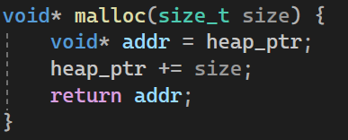
Dynamic memory is in the heap
int[] p = new int[ someVariableSize ];
The heap is just a memory location.
Simplest heap possible:
COMP 520: Compilers – S. Ali

Slide 88
Super-simple heap
Heap End: 0x8FFF FFFF
Heap Ptr
Heap Base: 0x8000 0000
COMP 520: Compilers – S. Ali

Slide 89
Super-simple heap
Heap End: 0x8FFF FFFF
I want 3072 bytes of data! malloc(3072)
new char[3072]
Heap Ptr
Heap Base: 0x8000 0000
COMP 520: Compilers – S. Ali

Slide 90
Super-simple heap
Heap End: 0x8FFF FFFF
I want 3072 bytes of data! malloc(3072)
new char[3072]
Heap Ptr
Returned start of allocated memory
Heap Base: 0x8000 0000
COMP 520: Compilers – S. Ali

Slide 91
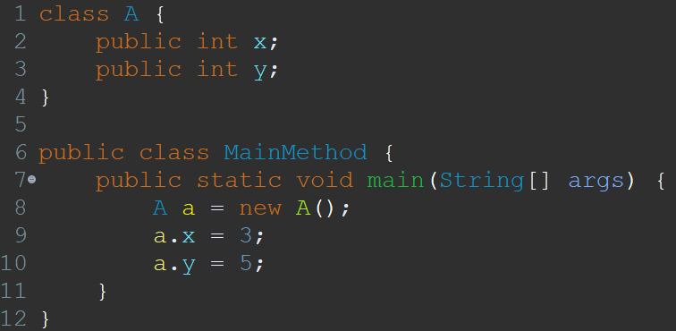
What does this look like?
Consider:
COMP 520: Compilers – S. Ali

Slide 92
How is something returned?
Assume [rbp+0E8h] is the variable a
Where is the returned value from the “new” operation?
COMP 520: Compilers – S. Ali

Slide 93
How is something returned?
FASTCALL, but assume push 8
Assume [rbp+0E8h] is the variable a
Where is the return value from the “new” operation?
COMP 520: Compilers – S. Ali

Slide 94
Assumptions
We will assume that all functions/methods return their value in rax
So rax will be “reserved” when doing a call, but general purpose otherwise
COMP 520: Compilers – S. Ali

Slide 95
What does this look like?
Consider:
push 8
call malloc
mov [a], rax
COMP 520: Compilers – S. Ali

Slide 96
What does this look like?
Consider:
push 8
call malloc
mov [a], rax
mov [rax+0],3
COMP 520: Compilers – S. Ali

Slide 97
What does this look like?
Consider:
push 8
call malloc
mov [a], rax
mov [rax+0],3
mov [rax+4],5
COMP 520: Compilers – S. Ali

Slide 98
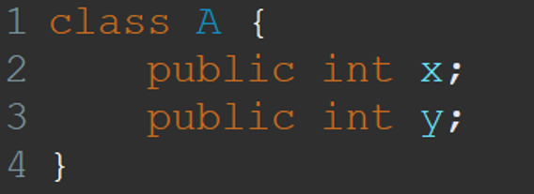
Field variables are offsets
x: From some base address, add +0
y: From some base address, add +4
COMP 520: Compilers – S. Ali

Slide 99
So how did we figure out the alloc size of “A”?
It has two variables, both of them are int, so assume int means 4 bytes (we will assume 8 bytes in miniJava), then the alloc size of A will be 8 bytes total.
COMP 520: Compilers – S. Ali

Slide 100
So how did we figure out the alloc size of “A”?
It has two variables, both of them are int, so assume int means 4 bytes (we will assume 8 bytes in miniJava), then the alloc size of A will be 8 bytes total.
Thus: push 8 call malloc
COMP 520: Compilers – S. Ali

Slide 101
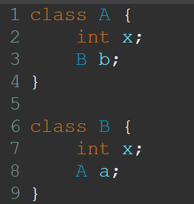
Coming up next!
How can we handle a.b.c.d.x?
What about classes like this:
What is their size?
(How many bytes is allocated when creating a new A()?)
COMP 520: Compilers – S. Ali

Slide 102
Review
COMP 520: Compilers – S. Ali

Slide 103
Review Lec 12
Basic assembly operations: mov from memory, add, subtract, store to memory (mov), call, push, pop, jmp, cmp, conditional jumps (jle,jl,jge,jg,je,jne)
Know about stack, heap, .bss, .data, .text
COMP 520: Compilers – S. Ali

Slide 104
Thursday
Live demo of branching
Will step through the assembly and show it in action
Will prove that assembly is just like any other thing you have programmed
COMP 520: Compilers – S. Ali

Slide 105
End

Slide 106
COMP 520: Compilers – S. Ali

Slide 107
COMP 520: Compilers – S. Ali

Slide 108
COMP 520: Compilers – S. Ali

Slide 109
COMP 520: Compilers – S. Ali

